Slide 1
Arrays and strings

Slide 2
Solve:
Write a simple program to take 7 numbers as input from the user and display the same….

Slide 3
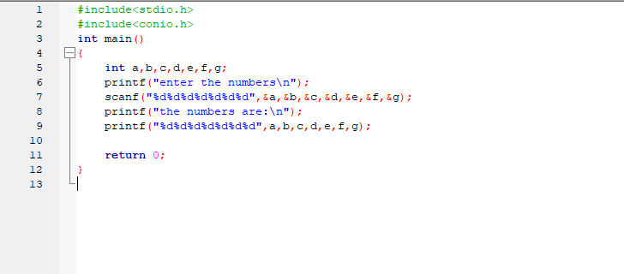

Slide 4
What is Array?
An array is a fixed-size sequential collection of elements of same data type that share a common name.
OR
It is the collection of element which are of the same data type.
An array is a derived data type.
An array is used to represent a list of numbers , or a list of names.

Slide 5
Example of Arrays:
For Example :
ν
1.List of employees in an organization.
2.Test scores of a class of students.
3.List of customers and their telephone numbers.
4.List of students in the college.
For Example, to represent 100 students in college , can be written as
student [100]

Slide 6
Types of Arrays
Types Of Array:
1.One-dimensional arrays
2.Two-dimensional arrays
3.Multidimensional arrays

Slide 7
One-dimensional Arrays
A one dimensional array (or single dimensional) is a type of linear array.
For Example , if we want to represent a set of five numbers say(35,40,20,57,19), by an array variable name number, then number is declared as follows
int number [5] ;

Slide 8
Declaring 1-D Arrays
The general form of array declaration is : type array-name[size];
→Here the type specifies the data type of elements contained in the array, such as int, float, or char.
→ And the size indicates the maximum numbers of elements that can be stored inside the array.
→ The size should be either a numeric constant or a symbolic constant.

Slide 9
Declaring one dimensional array:
If we declare an array as
Int array[5]:
array[0] array[1] array[2] array[3] array[4]
Here 0,1,2,3,4 refers to the index number of the array .
The elements of the array share the same variable name but each element has its own index number or subscript.
Always index number starts with 0.
10 | 20 | 30 | 40 | 50

Slide 10
One-dimensional Arrays
int number[5];
The computer will store these numbers as shown below : number [0]
number [1]
number [2]
number [3]
number [4]
The values can be assigned to the array as follows :
number [0] = 35;
number [1] = 40;
number [2] = 20;
number [3] = 57;
number [4] = 19;

Slide 11
Example
int group [10] ;
→ Here int is type, group is a variable name , 10 is the size of the array and the subscripts (index) is from 0 to 9.
→ If the size of the array is ‘n’ then the last index number will be ‘n-1’.

Slide 12
MEMORY ALLOCATION OF THE ARRAY:
Static memory allocation is an allocation technique which allocates a fixed amount of memory during compile time.
In static memory allocation ,memory is allocated while writing the program i.e allocation is done before the execution program .
Each data type will have its own memory size…. For example char type takes 1 byte of memory and type int takes 4 bytes of memory.
The memory address of the first element of an array is called first address , foundation address or base address.

Slide 13
INITIALIZATION OF ONE-DIMENSIONAL ARRAYS :
An array can be stored in following stages :
→ At compile time
→ At run time
Compile time initialization:
In compile time initialization, the array is initialized when they are declared.
The general form of initialization of array is :
type array-name[size] = { list of values };
The list of values are separated by commas.

Slide 14
Compile time initialization
Example :
int number[3] = {4,5,9};
→ Here array’s size is 3 and will assign
4 to first element(number[0]),
5 to second element(number[1]) and
9 is assigned to the third element(number[2]).
→ If the number of values in the list is less than the size of the array, then the remaining elements will be set to zero automatically.

Slide 15
Compile time initialization
Example: int number[4 ] = {1,2,3,4};
The character array can be initialized as follows :
char name[ ] = {‘U’,’V’,’C’,’E’,’\0’};
The character array can also be initialized as follows : char name[ ] = “uvce”;

Slide 16
Run time initialization
→ In run time initialization, the array is explicitly initialize at run time.
→ This concept generally used for initializing large arrays. Example:
for(i=0; i < 100; i++)
{
scanf(“%d”,&a[i]);
}
13

Slide 17
Solve:
Write a program to take 7 numbers as input from the user and display the same using the array concept…

Slide 18
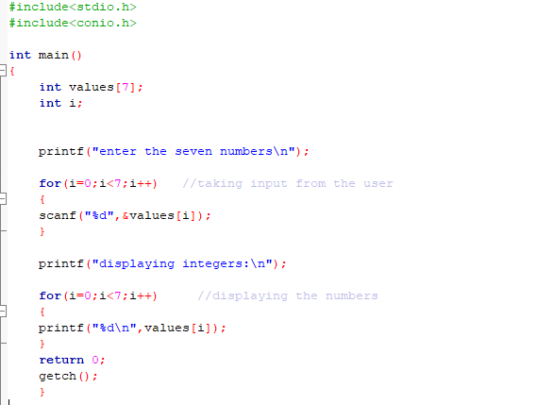

Slide 19
Solve:
Write a program to find the average of ‘n’ numbers using arrays..

Slide 20
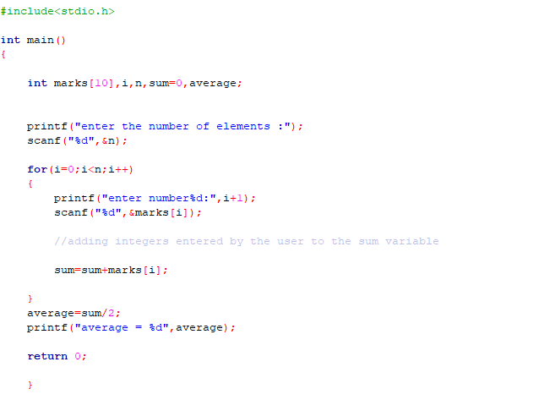

Slide 21
Two-dimensional Arrays
An array of arrays is known as two dimensional array .
The best example for two dimensional array is matrix which contains a table of rows and columns.
In Two dimensional arrays, the data is stored in rows and columns format.
For example:
int table[2][3];

Slide 22
Declaring 2-D Arrays:
The general form of two dimensional array declaration is :
type array-name[row_size][column_size];
→ Here the type specifies the data type of elements contained in the array, such as int, float, or char.
→ The size should be either a numeric constant or a symbolic constant.

Slide 23
INITIALIZATION OF 2-D ARRAYS :
→ The general form of initializing two-dimensional array is :
type array-name[row_size][column_size] = {list of values};
Example :
int table[2][3] = {0,0,0,1,1,1};
→ Here the elements of first row initializes to zero and the elements of second row initializes to one.
→ This above statement can be written as : int table[2][3] = {{0,0,0}, {1,1,1}};
→ In two-dimensional array the row_size can be omitted.

Slide 24
INITIALIZATION OF 2-D ARRAYS :
Example :
int table[3][3] = {{0,0,0}, {1,1,1}};
→ If the values are less than the declared size, then the remaining are automatically set to zero.
Example :
int table[2][3] = {1,1,2};
Here first row initialize to 1,1 and 2, and second row initialize to 0,0 and 0 automatically.

Slide 25
Memory Layout of 2-D Array :
→ In Two dimensional arrays, the data is stored in rows and columns format.
For example:
int table[2][3] = {1,2,3,4,5,6};
→ The memory layout of above example :
table[0][0] = 1;
table[0][1] = 2
table[0][2] = 3;
table[1][0] = 4;
table[1][1] = 5;
table[1][2] = 6;

Slide 26
Multi-dimensional Arrays
→ A variable which represent the list of items using more than two index (subscript) is called multi-dimensional array.
→ The general form of multi dimensional array is : type array_name[s1][s2][s3]…….[sn];
Where S is the size.

Slide 27
Multi-dimensional Arrays
Some examples are :
int survey[3][5][6];
float table[5][4][5][3];
Here survey is a three-dimensional array and table is a four-dimensional array.

Slide 28
Applications Of arrays
Array can be used for sorting elements.
Array can perform matrix operations.
Array can be used for mathematical calculations.
Passing arrays as function parameters.
Arrays as members of structures.
Array can be used for searching elements.
Manipulating character arrays and strings.

Slide 29
Linear search:
Linear Search is a method for finding an element within a list .
Linear search is also called as sequential search.
It sequentially checks each element of the list until a match is found or whole list has been searched.
It is the most basic type of searching algorithm.

Slide 30
Linear search:
Write a program for linear search.

Slide 31
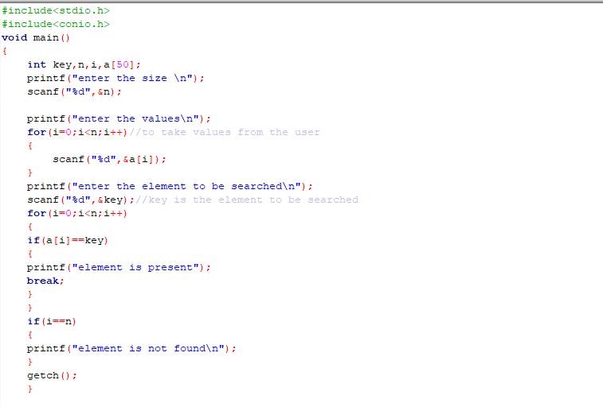

Slide 32
Strings
Introduction
Reading and displaying strings
String handling functions

Slide 33
Introduction
Strings are array of characters i.e. they are
characters memory. string.
arranged one
after
another in
Thus, a character array is
called
Each character
of the string is
stored
within one element of the array successively.
A string is always terminated by a null character (i.e. slash zero \0).

Slide 34
Implementation
C implements the string data structure using arrays of type char.
Since string is an array ,the declaration of a string is the same as declaring a char array.
When the compiler assigns a character string to a character array , it automatically supplies a null character (‘\0’) at the end.
The size of the string should be equal to the maximum number of characters in the string plus one.

Slide 35
Memory storage
A string will always end with a null character ‘\0’.
The characters after the null character are ignored.
e.g., char str[20] = “initial value”;
[0]
[13]
I | n | i | t | i | a | l |  | v | a | l | u | e | \0 | ? | ? | …

Slide 36
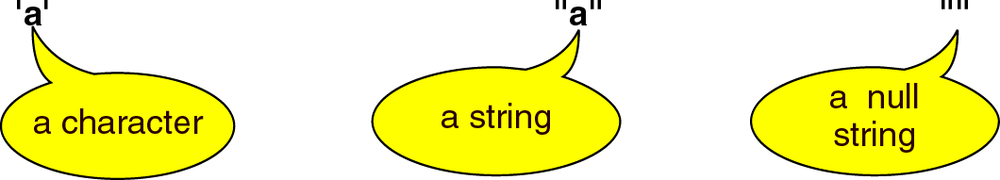
String in C – Character vs. String

Slide 37

Initializing String Variables
Strings are initialized in either of the following two forms: char name[4]={‘R’,‘A’,‘M’, ‘\0’};
char name[]={‘R’,‘A’,‘M’, ‘\0’};
char name[4]=“RAM”; char name[]=“RAM”;
R | A | M | \0
name[0] | name[1] | name[2] | name[3]
When we
initialize a character array by listing its
elements, the null terminator or the size of the array must be provided explicitly.

Slide 38
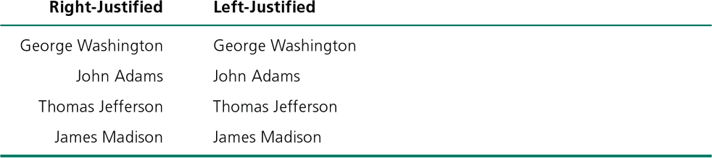
String in C- Right and Left justification of strings
The string can be right justified placing a positive number in the placeholder.
- printf(“%8s”, str);
The string can be left justified by placing a negative number in the placeholder.
Printf(“%-8s”, str);

Slide 39
Solve:
Write a program to print your name …

Slide 40
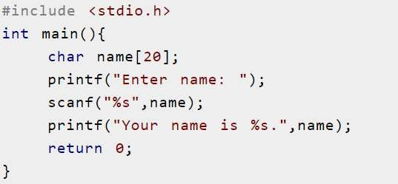
Using printf() and scanf()

Slide 41
String handling functions
Strings need to be manipulated by programmer.
It can be done manually but is time consuming.

Slide 42
Arrays and Strings…
Operations performed on include:
Reading and writing strings
Copying one string to another
Combining strings together
Comparing strings for equality
Extracting a portion of a string
character
strings

Slide 43
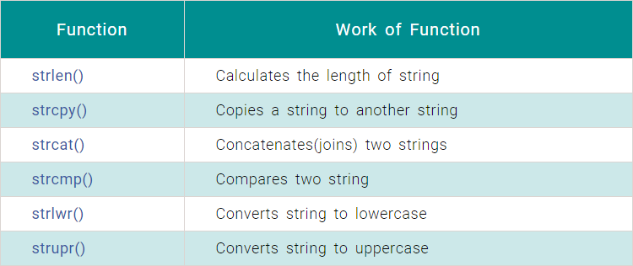
There are various string handling functions define in string.h some of them are:

Slide 44
THANK YOU

